Slide 1


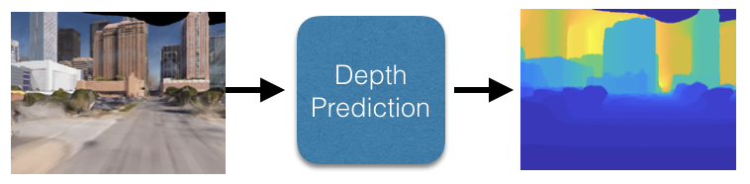
FarSight: Long Range Depth Estimation in Outdoor Images
Philip David
US Army Research Laboratory
Adelphi, Maryland, USA
Notes:
Hello everyone,
I am … In this talk titled “FarSight: Long Range Depth Estimation in Outdoor Images”, today I am going to talk about
This work came out as a joint-research from George Mason University and US Army Research Lab.

Slide 2
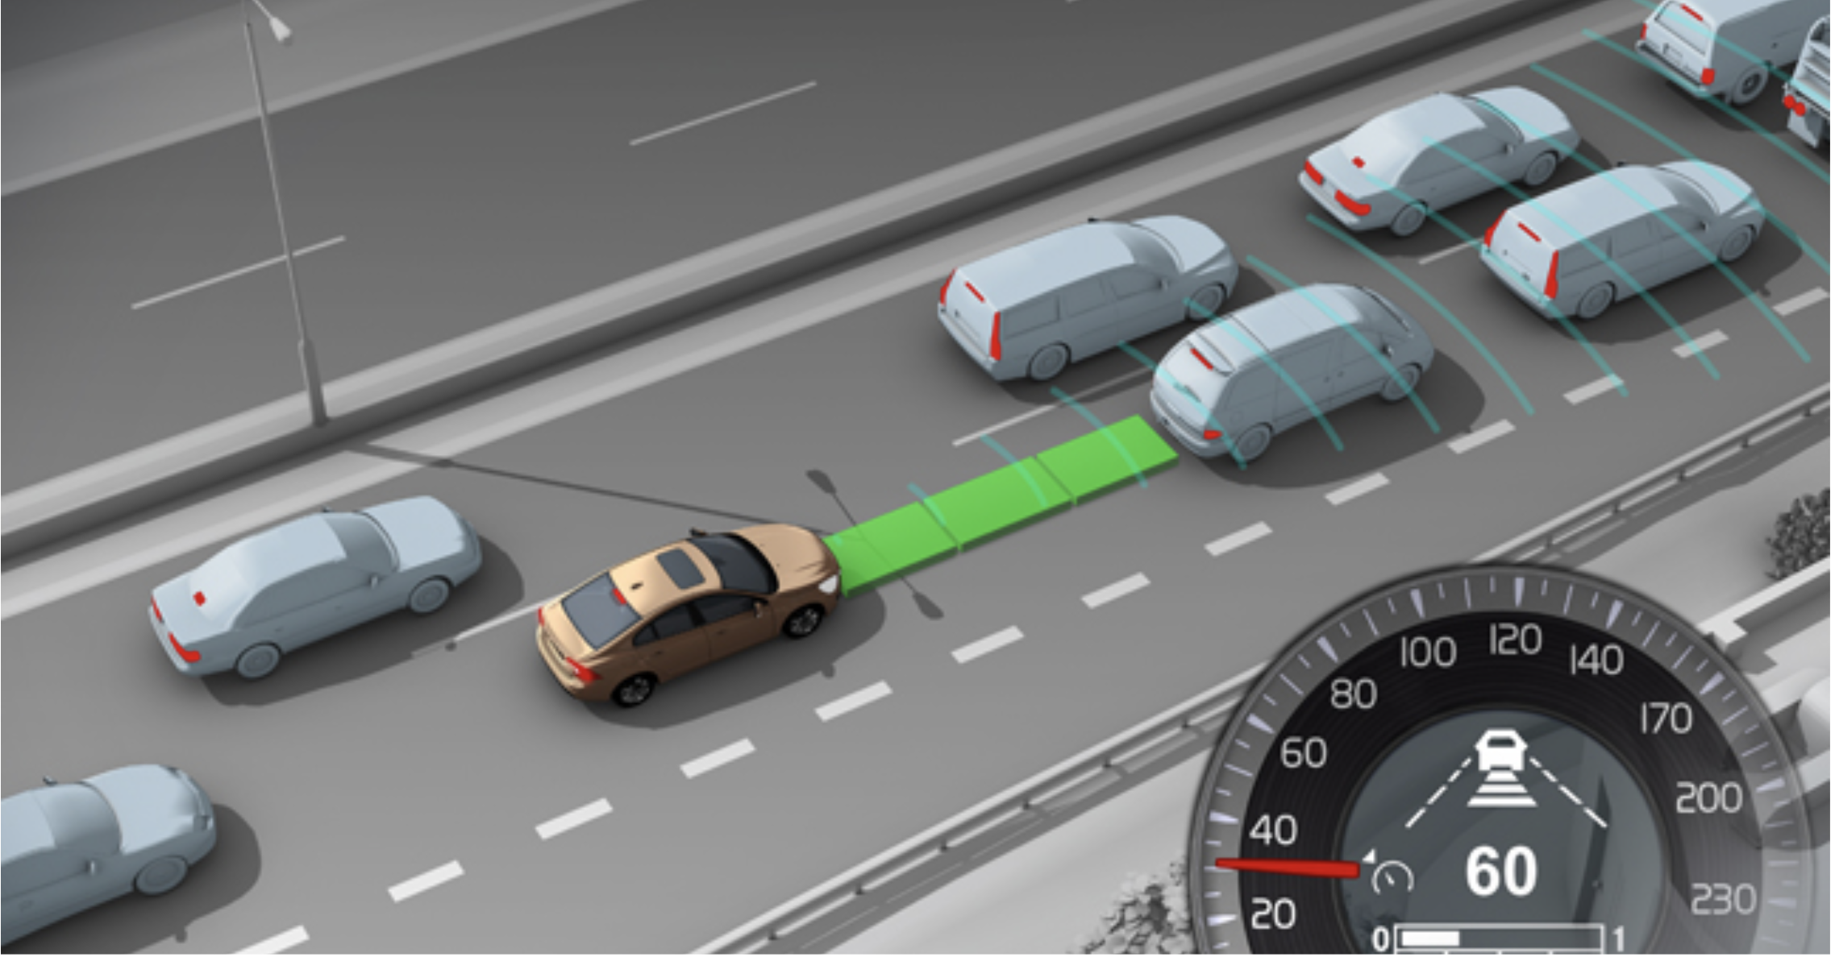
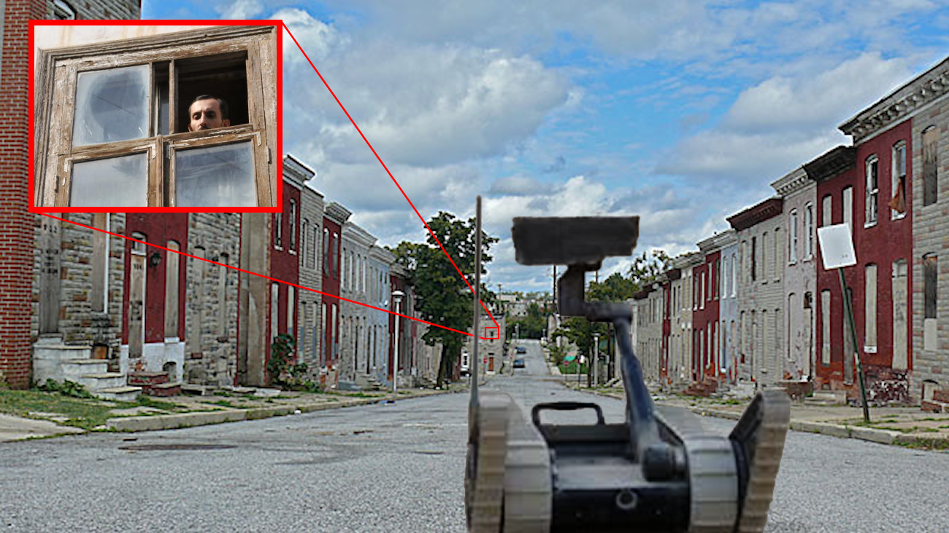
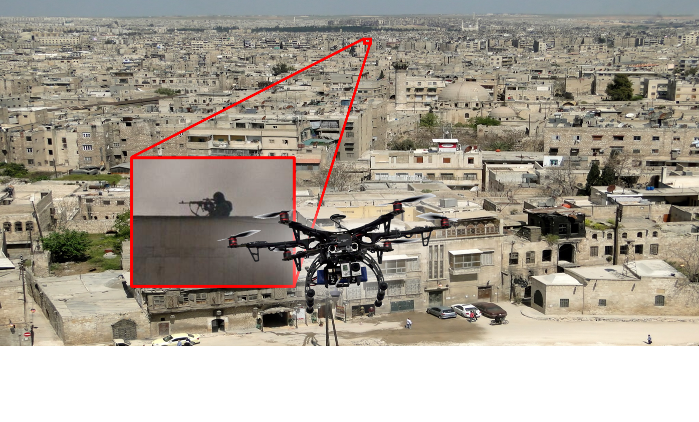

Depth Estimation in RGB Images
Motivation
Outdoor image may contain object at a far-away distance
Useful for an autonomous robot to find depth of a distant object
object detection in military mission
surveillance
autonomous driving etc
Figure: Long-range surveillance
Figure: Mega city surveillance
Topic 2: Depth Estimation in RGB Images
Notes:
The ability to detect/classify objects and activities at a long range of distances is important capability for autonomous vehicles
Knowing the distance of the object from the robotic system will help in turn detecting the object.
It has useful applications for autonomous military mission, surveillance, and autonomous driving

Slide 3
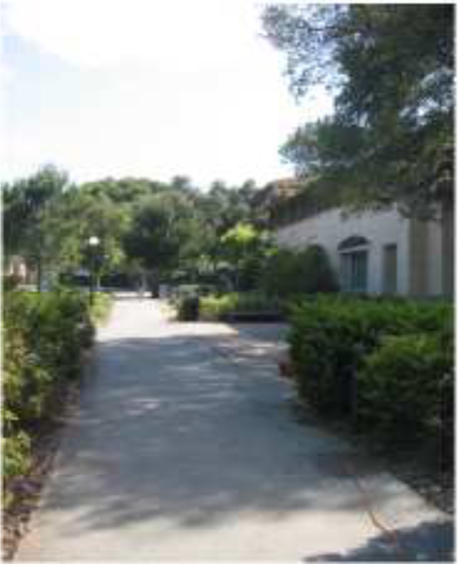
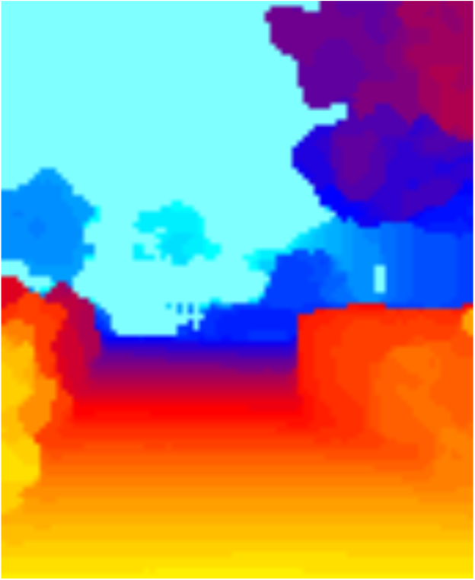
Depth Estimation in RGB Images
Difficulties with existing approaches
Most of monocular depth estimation algorithms provide depth estimates less than 100 meters
Depth sensors (eg, Laser, LIDAR) have limited range:
- Make3D: Learning 3D SceneStructure from a Single Still Image, A.Saxena, M. Sun, andA.Ng, PAMI 2009.
- Are we ready for autonomous driving? The KITTI vision benchmark suite. A. Geiger, P. Lenz, and R. Utrasun, CVPR 2012.
Figure: RGB and Depth pair from Make3D dataset
Topic 2: Depth Estimation in RGB Images
Notes:
In traditional settings depths are estimated using different physical sensors such as LIDAR, Laser etc.
Given these sensors data as training data, depth estimation can be formulated as a supervised learning problem. The pioneering work of Saxena et al. allowed robots to estimate depth in each pixel from a single image. For training the model for depth prediction, features are computed from input RGB images, the model is trained for depth prediction.
These LIDAR sensors can estimate depth up to 80 meter which is major limitation when object appears at a distant.

Slide 4
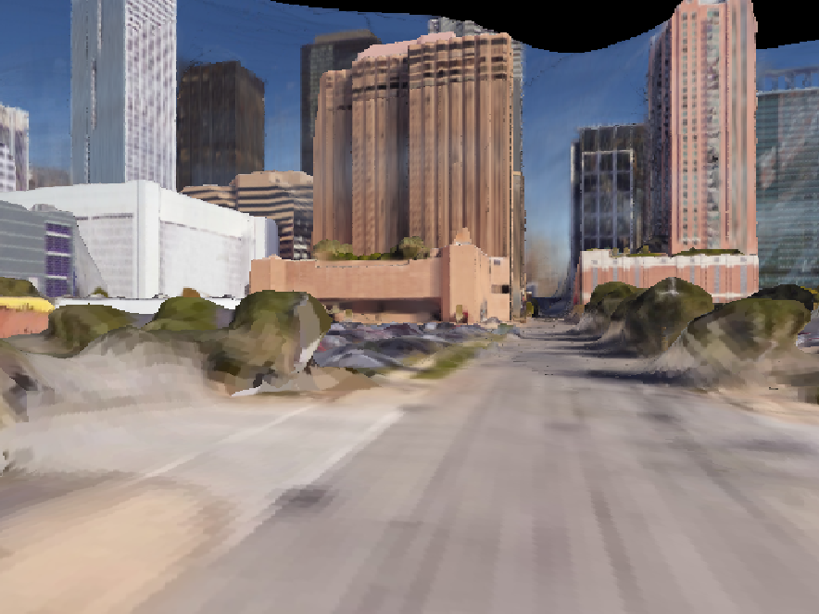

Contributions
Proposed deep neural network based algorithms that can predict the depth from an image
Developed an RGB and Depth image pair generation algorithm that goes up to 1000 meters
utilizing 3D reconstruction of the scene from multi-view images
Figure: RGB and generated Depth images in the city of Houston, Texas
Topic 2: Depth Estimation in RGB Images
Notes:
To address the limitation of LIDAR sensor, I proposed a new method for providing depth up to 1000 meters from 3D reconstruction of a scene
Utilizing the depth images, then I proposed two deep neural network based learning algorithm for depth prediction from a single RGB image
In the following slides, I will discuss the proposed depth generation method and depth prediction models.
$$ talked about it in the previous slide
motivation for why human can do it and
can we do something similar with training data + learning a model

Slide 5
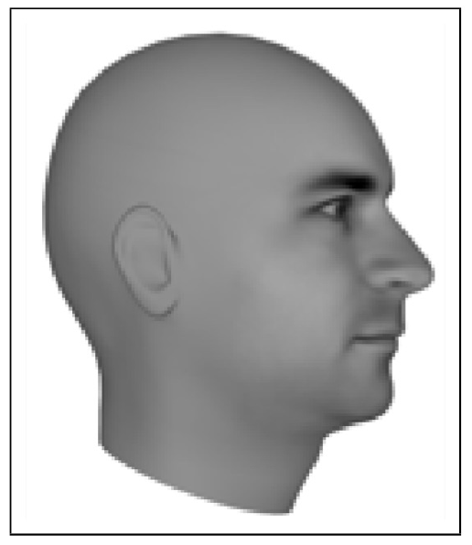
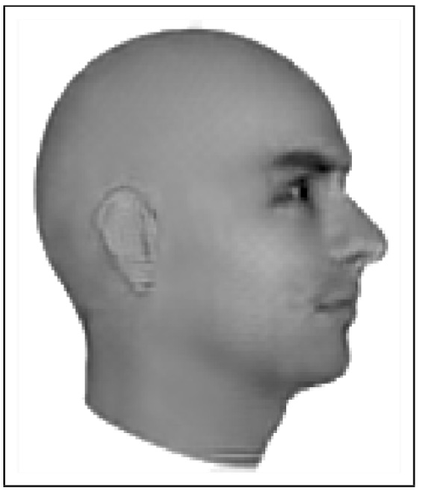
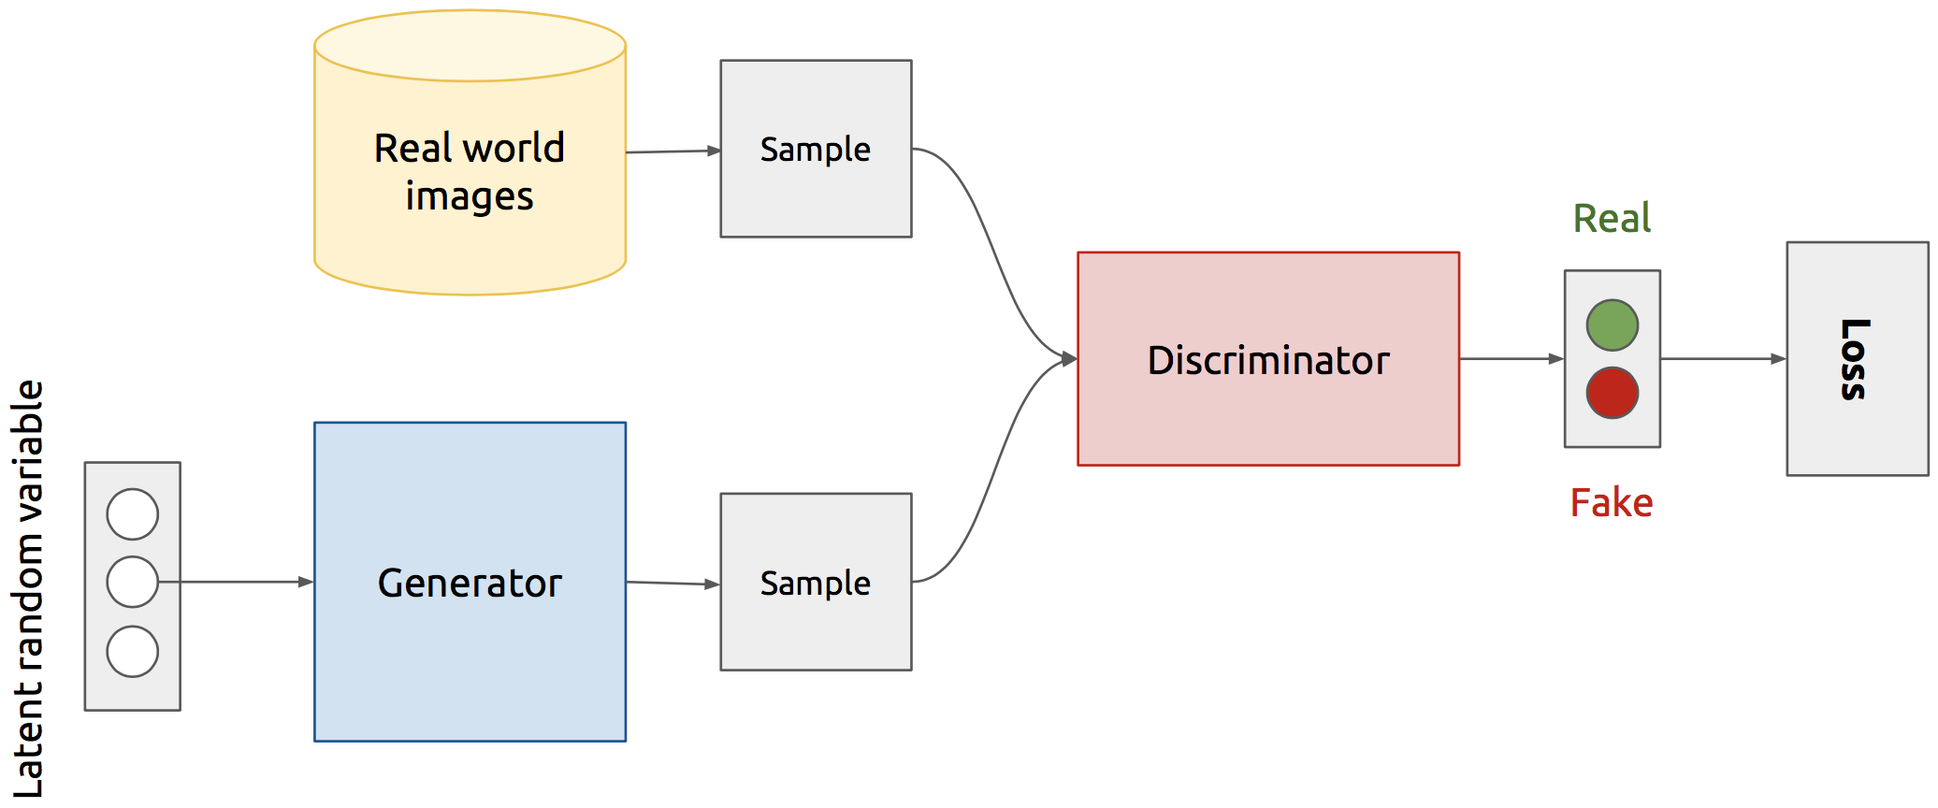
Depth Prediction using Deep Neural Networks
Ground Truth
Generated from GAN
Generative Adversarial Network (GAN):
Consists of 2 networks:
Generator G: tries to samples from an input noise vector
Discriminator D: tries to distinguish between samples (fakes) from generator and samples from real data distribution
Combined network is adversarially trained
Figure: Overview of the GAN architecture. Reference: Deep Learning for Computer Vision Barcelona Summer Seminar 2016
Topic 2: Depth Estimation in RGB Images
Notes:
$ introduce the diffference between the generative model vs discriminative add Goodfellow reference
I proposed two different deep neural network based method for depth prediction. First one of them is based on a Generative Adversarial Network or GAN.
GAN is a generative model that can generate new image given an input noise vector.
Figure on the bottom shows a generic architecture of a GAN. A GAN has two components: a generator G and a discriminator D.
The combined network is adversarially trained where the goal of the generator G is to produce images that fool the discriminator D into identifying ‘fake’ images as ‘real’ ones.
The D is trained as well to discriminate ‘fake’ images from the ‘real’ ones.

Slide 6
Depth Prediction using Deep Neural Networks
Conditional Generative Adversarial Network (cGAN*):
Depth prediction as an image-to-image translation problem using cGAN, where the goal is to translate an RGB image (source domain) to a depth image (target domain)
Ground truth depth
Corresponding RGB
Generator Network
+ ve
Discriminator Network
RGB
RGB
Input
Real or Fake
Noise
- ve
Generated depth
Figure: GAN architecture for depth prediction
*P. Isola, J. Zhu, T. Zhou, A. Efros, Image-to-Image Translation with Conditional Adversarial Networks, (CVPR), 2017
Topic 2: Depth Estimation in RGB Images
Notes:
For our case for depth estimation, we used conditional GAN. In cGAN in addition to a noise vector, we input to the Generator G the RGB image for depth prediction.
Depth prediction can be thought of as an image-to-image translation problem, where the goal is to translate an RGB image which is the source domain to a depth image which is the target domain.
Figure shows the architecture of the cGAN. Previous works demonstrates that similar translation task for various other domains such as edge-2-rgb, rgb-2-semantic-segmentation. Here we demonstrated that depth prediction can formulated as rgb-image-2-depth-image translation task.

Slide 7
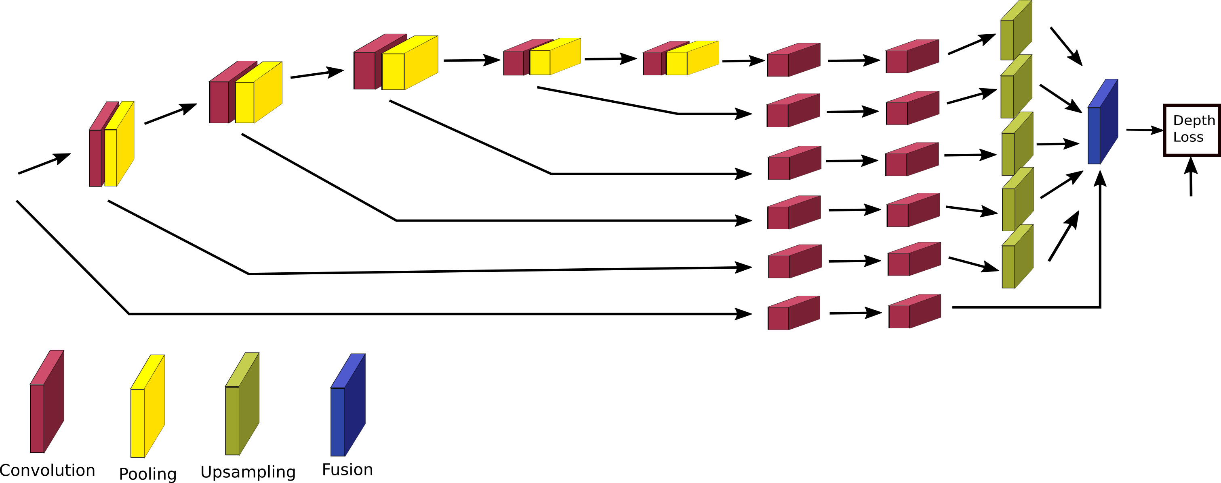
Depth Prediction using Deep Neural Networks
Convolutional Neural Network (CNN):
Followed a variation of the CNN architecture proposed by Mousavian et al.* , the network in our setting is trained to predict depth only
RGB input
Ground truth
Depth labels
Figure: CNN architecture for depth prediction
*A. Mousavian, H. Pirsiavash, J. Kosecka, Joint Semantic Segmentation and Depth Estimation with Deep Convolutional Networks, In 3D Vision (3DV), 2016
Topic 2: Depth Estimation in RGB Images

Slide 8
Long Range Depth Data Generation
Collect urban images of a geolocation (eg, New York City, Chicago, Houston) using Google Earth software
Reconstruct the 3D model from the images
Annotate key points for the trajectory along the model
Render the RGB+ Depth image pairs along the trajectory
Topic 2: Depth Estimation in RGB Images
Notes:
Before we delve into the experiments lets talk about the data generation process that circumvents the limitation of traditional sensors that generates depth unto 80 meters only.
The steps for depth data generation that goes beyond 100 meters up to 1000 meters are shown here.
We collect urban images of a geolocation such as NYC, Chicago, Houston etc using Google Earth software.
A subsampled of these images are utilized to reconstruct the 3D model of the city.
Then we fix the trajectory along the 3D model and utilize the trajectory to render the RGB and depth image pairs. This allows us to gather huge number of rgb,depth image pairs from each reconstructed model.

Slide 9
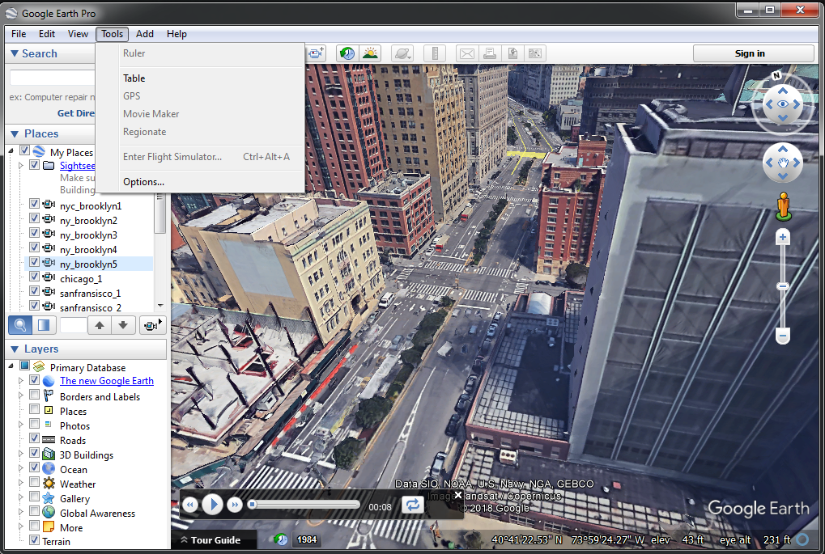
Long Range Depth Data Generation
Image Collection:
Extract images (street view) of a city eg, NYC from multiple viewpoints
Google Earth allows to record a video-clip of a city as user hover around from different viewpoints
Extracted images are sampled for 3D reconstruction using Adobe Remake
Figure: Collection of a video clip from Google Earth Pro in New York City. The Movie Maker feature enables this option. Images are exported from the recorded video clip at 30 fps.
Topic 2: Depth Estimation in RGB Images
Notes:
Here we demonstrate the google-earth interface for recording a video clip in a city. We choose the popular cities across the USA for our image collection. This figure demonstrates the video-clip recording of a portion of NYC.
The images are extracted 30 fps from each video clip and we subsample a subset frames from that captures the recorded city from multiple view points.
This subsample set of frames are then utilized to 3D reconstruct the model of the city.

Slide 10
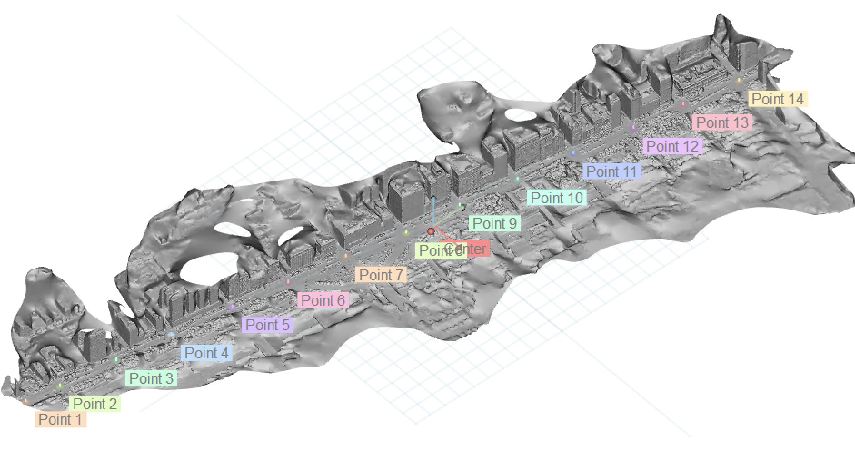
Long Range Depth Data Generation
3D Model Reconstruction:
Model of the city is reconstructed from a subset of manually selected images (120~250)
Figure: An example 3D reconstructed model from our dataset. The keypoints (Point 1, Point 2, Point 3, etc.) are manually selected in the 3D model.
Topic 2: Depth Estimation in RGB Images
Notes:
Figure here demonstrates the 3D reconstructed model of the Chicago city - the longest model in our repositories.
After we 3D reconstruct the model we manually annotate several key-points inside the 3D model. The intersections of the streets are chosen to be the key-points. The key-points are demonstrated in the figure in different colors. The texture of the 3D model is turned off for better visibility of the key-points.

Slide 11
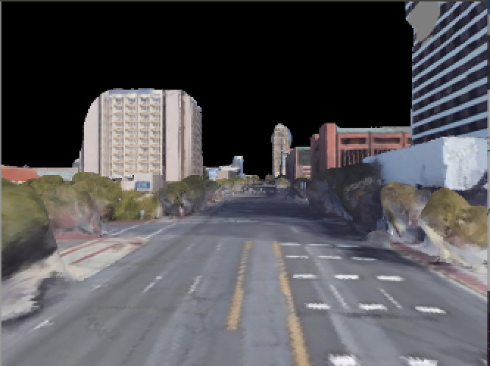
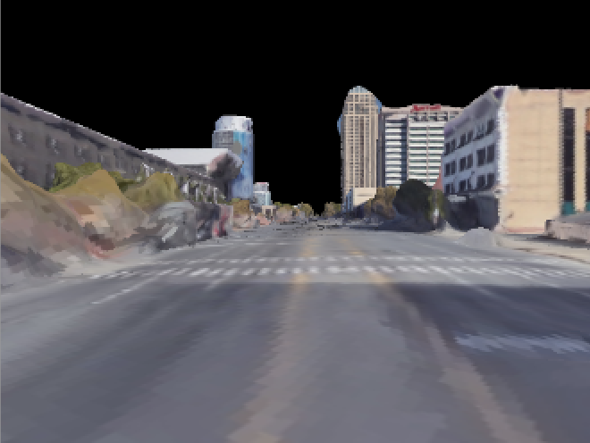
Long Range Depth Data Generation
Render the Model using OpenGL for a Fixed Trajectory:
Generate a trajectory of a moving virtual camera between two keypoints A and B in the 3D model
Render the scene from the viewpoint of the virtual camera using OpenGL from each point along the trajectory
Figure: Two snap-shots of the rendering process in two different virtual camera trajectory locations inside the Salt Lake City reconstructed 3D model.
Topic 2: Depth Estimation in RGB Images
Notes:
Once the key-points are defined, between two keypoints A and B in the 3D model we generate a trajectory of a moving virtual camera. During trajectory generation we move forward from key-point A to key-point B by a fixed distance.
From each point along the trajectory, we render the scene from the viewpoint of the virtual camera using OpenGL. Figure demonstrates two snapshots of the rendered image from the 3D reconstructed model in Salt-Lake City.

Slide 12
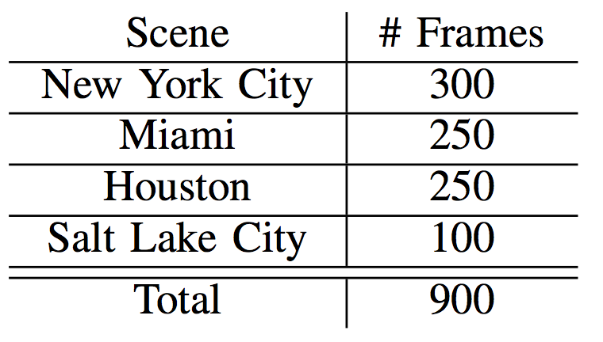
Experiments
Trained two DNN networks using the quantized depth values as ground truths
Generative Adversarial Network (GAN)
Convolutional Neural Network (CNN)
Evaluated depth prediction on 3 metrics:
Absolute Relative Error
Linear RMSE
Scale Invariant RMSE
Topic 2: Depth Estimation in RGB Images

Slide 13
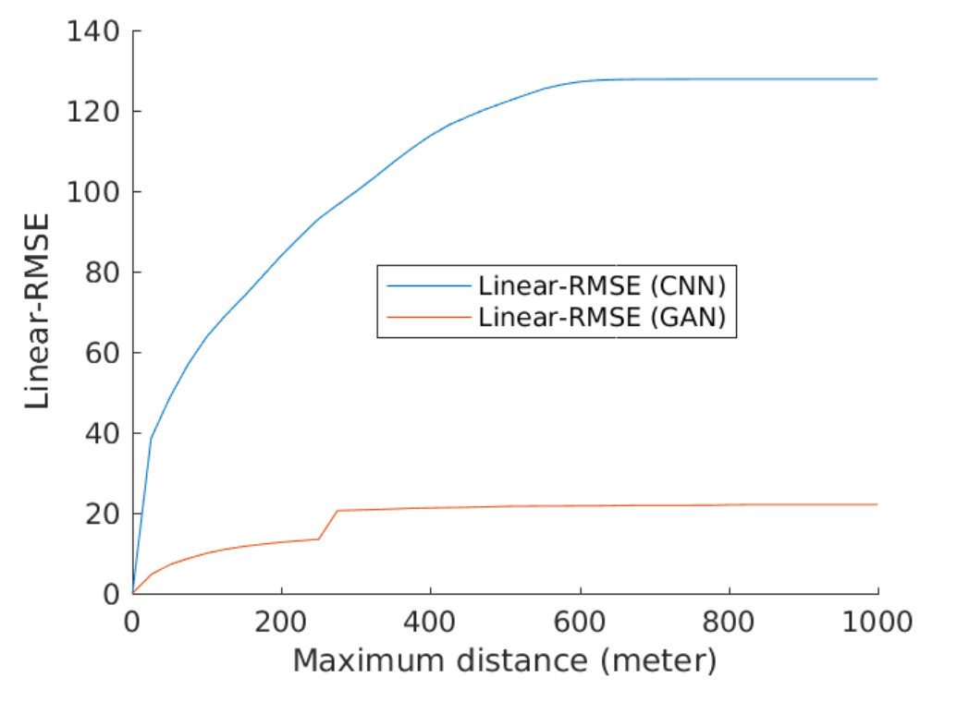
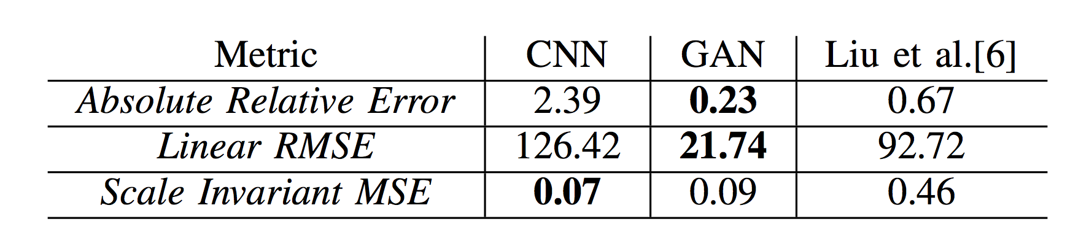
Experiments
Experiment:
GAN model to predict depth better than the CNN
Compared against method of Liu et al.*
*Liu et al., Deep Convolutional Neural Fields for Depth Estimation from a Single Image, In (CVPR), 2015
M. Reza, P. David, and J. Kosecka, “FarSight: Long-Range Depth Estimation from Outdoor Images”,
IEEE/RSJ International Conference on Intelligent Robots and Systems (IROS)-18
Topic 2: Depth Estimation in RGB Images
Notes:
drop the Experiment bullet

Slide 14
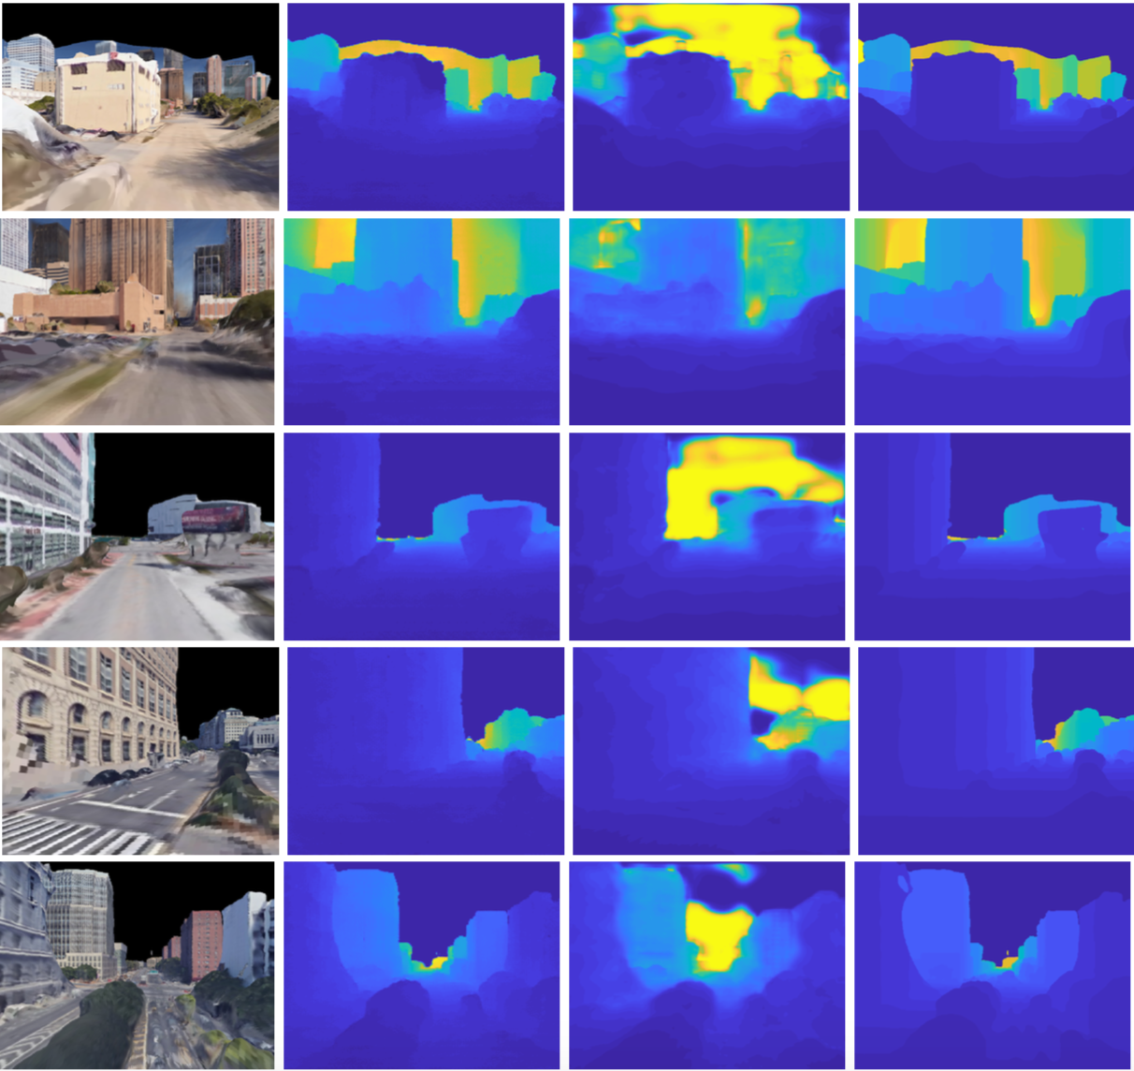
Visualization of the Depth Prediction
Figure: (From left to right) the input RGB image, the prediction from GAN model, prediction from CNN model, and the ground truth depth.
Topic 2: Depth Estimation in RGB Images

Slide 15
Conclusions
Novel ground truth depth image generation method
Trained two deep neural network based models for depth prediction
GAN-based model performed better than the CNN-based model
Topic 2: Depth Estimation in RGB Images

